Slide 1
CDA 3101 Spring 2016
Introduction to Computer Organization
The Arithmetic Logic Unit
(ALU) and MIPS ALU Support
04 February 2016
Notes:
We will study how the algorithms for the basic operations on the number representation we are using (2’s complement) are implemented using the lower level support (digital design elements: gates). ALU central to all MIPS instructions.

Slide 2
Overview
Hardware building blocks
ALU design
ALU implementation
1-bit ALU
32-bit ALU

Slide 3
Hardware Building Blocks
ALUs are implemented using lower level components (logic gates)
Gate (review)
  Hardware element that receives a certain number of inputs and produces one output
  Can be represented as a truth table or logic equation
  Gates in turn are implemented with transistors
ALU Building Blocks (review)
  And gate
  Or gate
  Inverter (not gate)
  Multiplexor (mux)

Slide 4
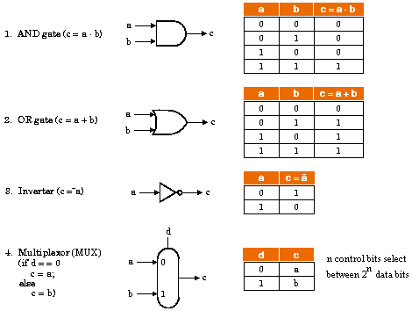
Basic Gates

Slide 5
Modular ALU Design
Facts
  Building blocks work with individual (I/O) bits
  ALU works with 32-bit registers
  ALU performs a variety of tasks (+, -, *, /, shift, etc)
Principles
  Build 32 separate 1-bit ALUs
  Build separate hardware blocks for each task
  Perform all operations in parallel
  Use a mux to choose the actual operation (make decision)
Advantages
  Easy to add new operations (instructions)
    Add new data lines into the muxes; inform “control” of the change.

Slide 6
ALU Implementation
Mux
Control lines (n)
Data lines (2^{n})
Output: one per mux
32-bit ALU uses 32 muxes (one for each output bit)
Go through instruction set and add data (and control) lines to implement the corresponding operations.

Slide 7
One-Bit Logical Instructions
Map directly onto hardware components
  AND instruction
    One of data lines should be a simple AND gate
  OR instruction
    Another data line should be a simple OR gate
Op (control)
Definition
A
Op | C
0 | A and B
1 | A or B
B
0
C
1

Slide 8
One-Bit Full Adder
. . . (0) (1) (0) (0) (0)
. . . 0 0 1 0 1
. . . 0 0 1 1 0
. . . 0 (0)1 (1)0 (0)1 (0)1
CarryIn
A:
B:
Sum:
Inputs
+
Outputs
CarryOut
Each bit of addition has
  Three input bits: A_{i}, B_{i}, CarryIn_{i}
  Two output bits: Sum_{i}, CarryOut_{i}
  ( CarryIn_{i+1} = CarryOut_{i} )

Slide 9
Full Adder’s Truth Table
Symbol
Definition
A
B
CarryIn
CarryOut
Sum
CarryIn
0
0
0
0
0
0
0
1
0
1
0
1
0
0
1
A
+
0
1
1
1
0
Sum
B
1
0
0
0
1
1
0
1
1
0
1
1
0
1
0
CarryOut
1
1
1
1
1
CarryOut = (A’*B*CarryIn) + (A*B’*CarryIn) + (A*B*CarryIn’) + (A*B*CarryIn) = (B*CarryIn) + (A*CarryIn) + (A*B)
Sum = (A’*B’*CarryIn) + (A’*B*CarryIn’) + (A*B’*CarryIn’) + (A*B*CarryIn)

Slide 10
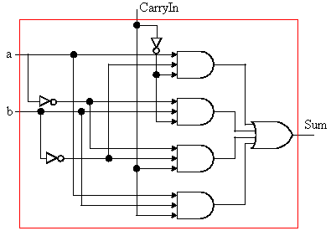
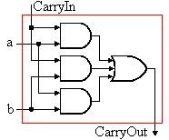
Full Adder Circuit (1/2)
Construct the gates for Sum
Implement the gates for CarryOut
Connect all inputs with the same name

Slide 11
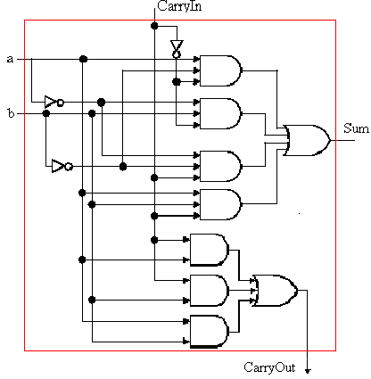
Full Adder Circuit (2/2)

Slide 12
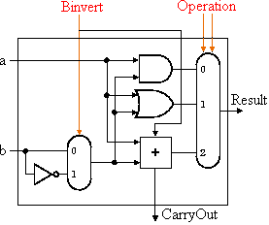
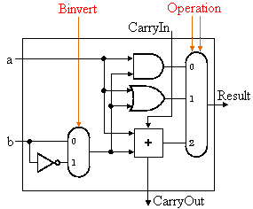
One-Bit ALU
Least significant bit
Other bits

Slide 13
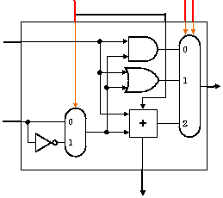
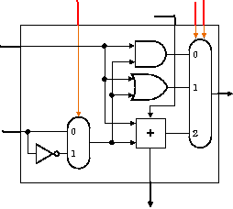
32-Bit ALU
Binvert
Operation
a₀
Result₀
b₀
a₁
Result₁
b₁
. . .
a₃₁
Result₃₁
b₃₁

Slide 14
Summary
Building blocks: basic gates (AND, OR, NOT)
Modular design and implementation
  Gates have multiple inputs and one output
  ALU works with 32-bit words (integers)
  ALU implements a variety of operations in parallel
  => Construct first a 1-bit ALU
  Mux chooses one of many different ALU operations
  From the architecture’s instruction set, add the basic ALU operations necessary to implement that instruction
  Two’s complement representation allows the use of the same hardware for both addition and subtraction

Slide 15

Anticipate the Weekend!!

Slide 16
Application to MIPS ALU
MIPS ALU extensions
Overflow detection
Slt instruction
Branch instructions
Shift instructions
Immediate instructions
ALU performance
  Performance vs. cost
  Carry lookahead adder
Implementation alternatives

Slide 17
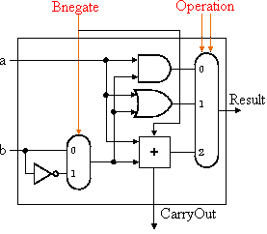
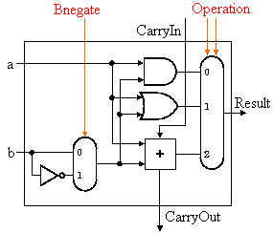
Recall: Generic One-Bit ALU
0 – ADD
1 – SUB
00 – AND
01 – OR
10 – ADD
AND
OR
First bit (LSB)
Other bits
Operations: AND, OR, ADD, SUB
Control lines: 000 001 010 110

Slide 18
Slt Instruction
Slt rd, rs, rt
A < B => A – B < 0
  Perform subtraction using full adder
  Check highest-order bit (sign bit)
  Sign bit tells us whether A < B
New input line (Less) goes directly to mux
New control line (111) for slt
Result for slt is not the output from ALU
  Need a new 1-bit ALU for the most significant bit
    It has a new output line (Set) used only for slt
    (Overflow detection logic is also associated with this bit)
1 if (rs < rt)
0 else
rd:
0000 0000 0000 0000 0000 0000 0000 000r

Slide 19
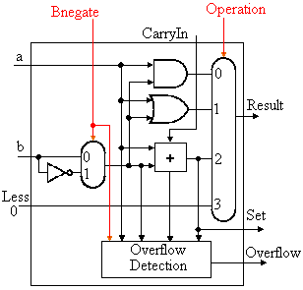
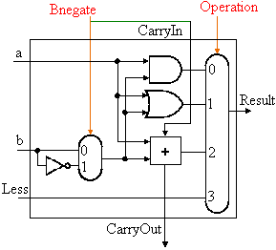
Slt Support
First bit (LSB)
Sign bit

Slide 20
Branch Instructions
beq $t5, $t6, L
  Use subtraction: (a-b) = 0 implies a = b
  Add hardware to test if the result is 0
  OR all 32 results and invert the OR output
  Zero = (Result₁ + Result₂ + .. + Result₃₁)
Consider A + B and A - B
  Overflow if
    A = 0 ?
    B = 0 ?

Slide 21
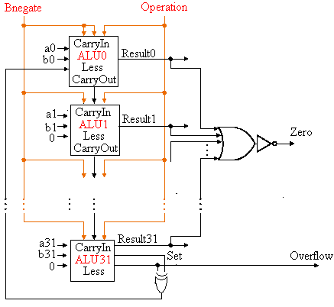
Branch Support
1 (A = B)
0 otherwise

Slide 22
Shift instructions
SLL, SRL, and SRA
We need a data line for a shifter (L and R)
However, shifters are much more easily implemented at the transistor level (outside the ALU)
Barrel shifters
x₃ x₂ x₁ x₀
Diagonal closed switch pattern controlled by the control unit
x₃ x₂ x₁ x₀
x₂ x₁ x₀ 0
0 x₃ x₂ x₁
Output, x
Output, x<<1
Output, x>>1

Slide 23
Immediate Instructions
First input to ALU is the first register (rs)
Second input
  Data from register (rt)
  Zero- or sing-extended immediate
Add a mux at second input of ALU
Registers
32
Sign extend
16
rs
rt
0 1
IR:
ALU
Control Unit
Zero
Result
Overflow
Memory address

Slide 24
ALU Performance
Is a 32-bit ALU as fast as a 1-bit ALU?
  Can you see the ripple?
Hardware executes in parallel
Speed vs. Cost
  Fewer sequential gates vs. number of gates
Two extremes to do addition
  Ripple carry and sum-of-products
How could you get rid of the ripple
  Two levels of logic
  c₁ = b₀c₀ + a₀c₀ + a₀b₀
  c₂ = b₁c₁ + a₁c₁ + a₁b₁ c₂ =
  c₃ = b₂c₂ + a₂c₂ + a₂b₂ c₃ =
  c₄ = b₃c₃ + a₃c₃ + a₃b₃ c₄ =

Slide 25
Carry-Lookahead Adder (1/2)
An approach in-between our two extremes
Motivation:
  If we didn't know the value of carry-in, what could we do?
  When would we always generate a carry? g_{i} = a_{i} b_{i}
  When would we propagate the carry? p_{i} = a_{i} + b_{i}
Did we get rid of the ripple?
c₁ = g₀ + p₀c₀
c₂ = g₁ + p₁c₁ c₂ = g₁ + p₁g₀ + p₁p₀c₀
c₃ = g₂ + p₂c₂ c₃ =
c₄ = g₃ + p₃c₃ c₄ =

Slide 26
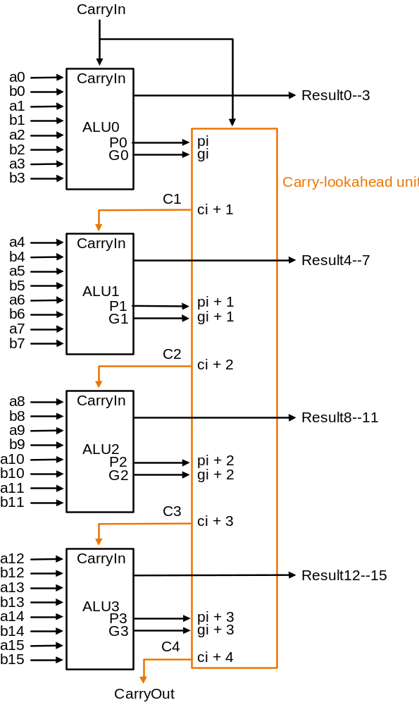
Carry-Lookahead Adder (2/2)
Can’t build a 16 bit adder this way... (too big)
Could use ripple carry of 4-bit CLA adders
Better: use the CLA principle again!

Slide 27
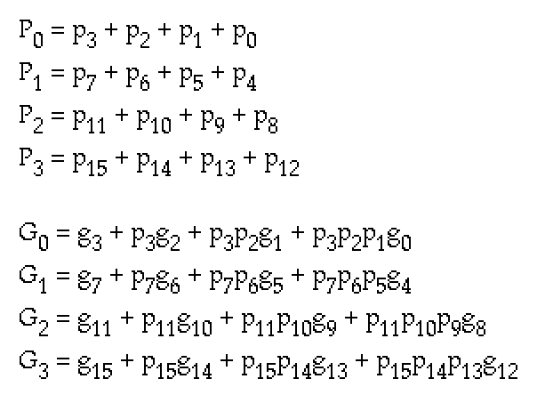
Second Level P and G

Slide 28
Ripple Carry vs. Carry Lookahead
Assume each gate (AND or OR) takes the same time
Total time = number of gates of longest path
Consider 16-bit adders
CarryOut signals c₁₆ and C₄ define the longest path
  Ripple carry: 2 * 16 = 32
  Carry lookahead: 2 + 2 + 1 = 5
    2 levels of logic in terms of P_{i} and G_{i}
    P_{i} is specified in one level of logic (AND) using p_{i}
    G_{i} is specified in two levels of logic using p_{i} and g_{i}
    p_{i} and g_{i} are each one level of logic in terms of a_{i} and b_{i}
A carry lookahead adder is six times faster

Slide 29
Implementation Alternatives
The logic equation for the sum output can be expressed more simply with XOR gates
  Sum = a XOR b XOR CarryIn
In some technologies, XOR is more efficient than two levels of AND and OR
Processors are designed now in CMOS transistors (switches)
CMOS ALU and barrel shifters have many fewer multiplexors than shown in our design
However, the design principles are similar

Slide 30
Conclusions
We can build an ALU to support the MIPS ISA
  Key Idea: Use multiplexer to select ALU output
  Subtraction uses two’s complement addition
  Replicate 1-bit ALU to produce 32-bit ALU
Important points about hardware
  All of the gates in the ALU work in parallel
  The speed of a gate is affected by the number of inputs
  Speed of a circuit is affected by the number of gates in series
  (on the critical path or the deepest level of logic)
Our primary focus: (conceptual)
  Clever changes to organization can improve performance
  (similar to using better algorithms in software)

Slide 31

Enjoy the Weekend!!

